Slide 1
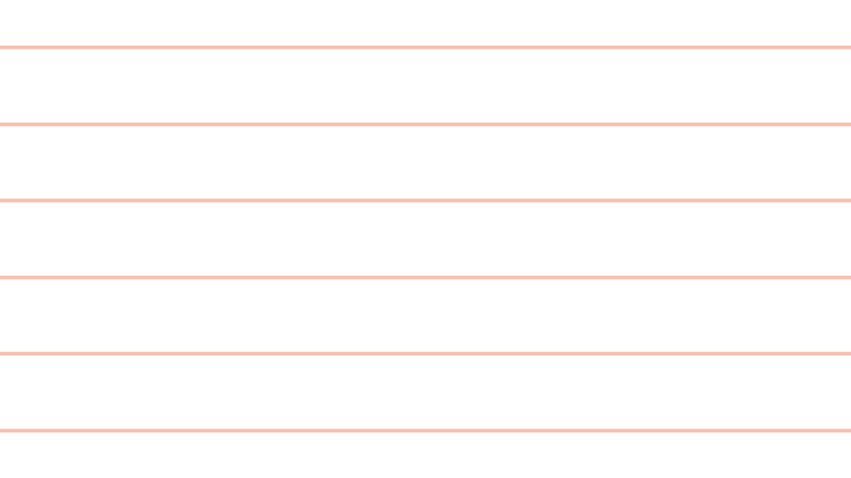
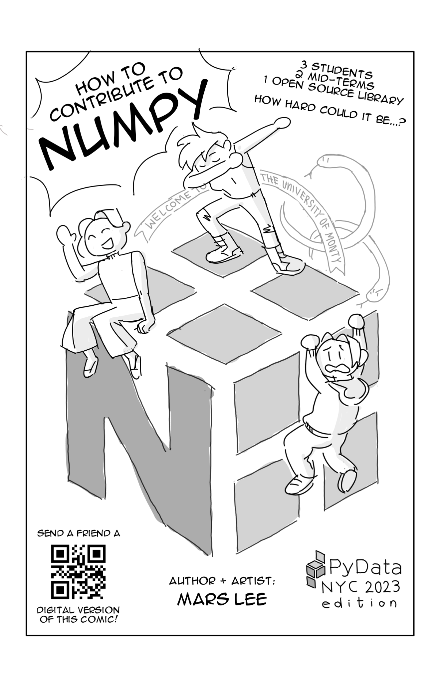
Comics in NumPy? More Likely
Than you Think!
Mars Lee
PyData NYC 2023
Notes:
Hello! Thank you everyone for coming to my talk! Comics in NumPy? More LIkely Than you Think!
Before we continue, I need everyone in the room to look in front of you. On your table, chair, whiteboard or lap is a comic. That’s right,

Slide 2

Notes:
YOU GET A COMIC

Slide 3

Notes:
YOU GET A COMIC

Slide 4

Notes:
EVERYONE GETS A COMIC!

Slide 5
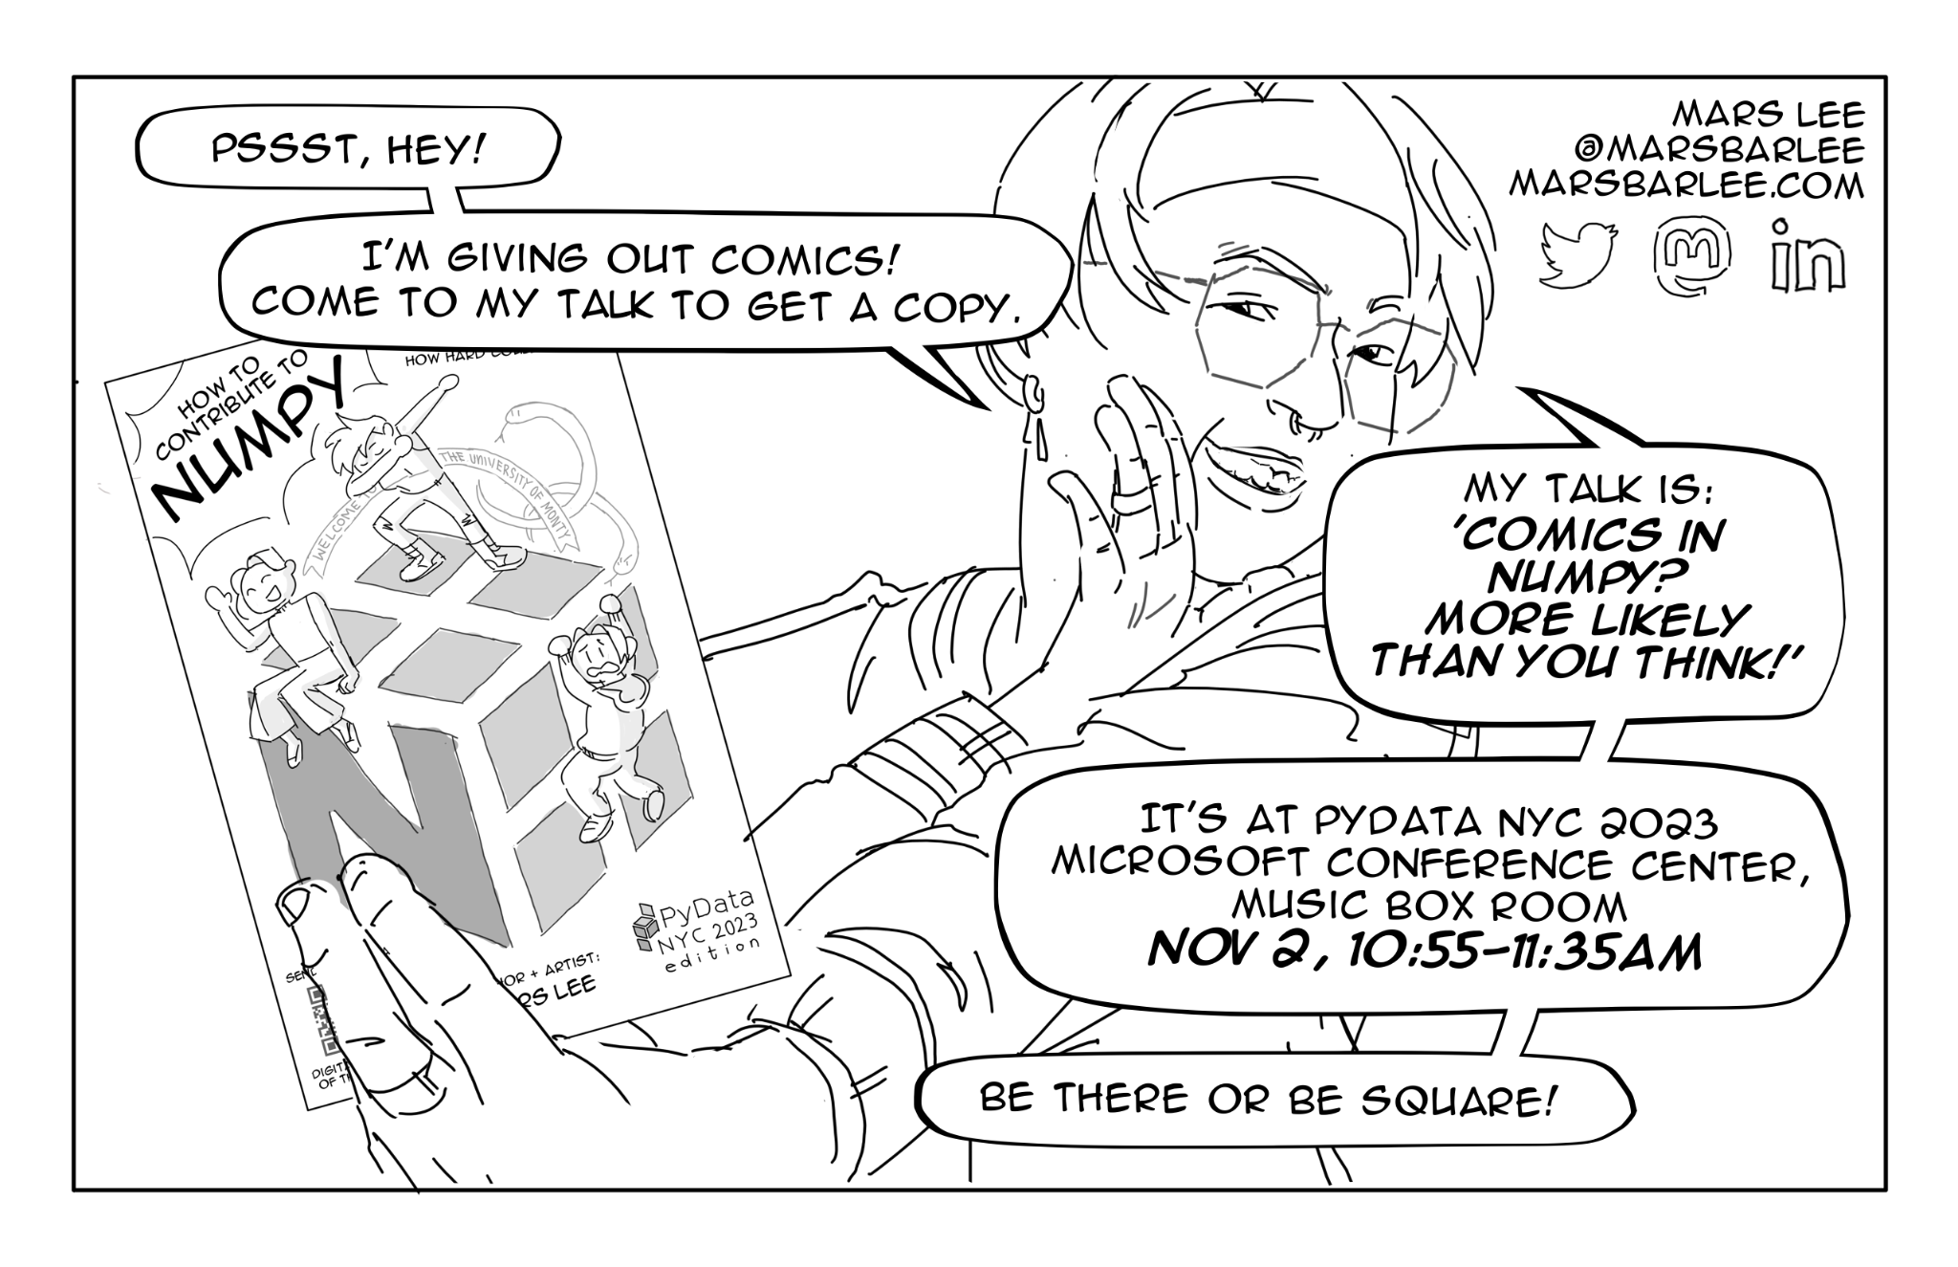
Notes:
EVERYONE GETS A COMIC BECAUSE I PROMISED EVERYONE I WOULD!

Slide 6
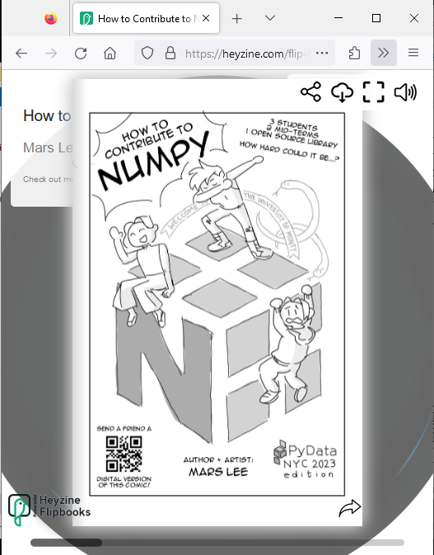

heyzine.com/flip-book/3e66a13901
Notes:
And if you’re watching remotely after the fact and do not have a comic in hand- don’t worry! There’s a digital version too! Here’s the QR code, and a URL for you quick finger masochists.

Slide 7

heyzine.com/flip-book/3e66a13901
Notes:
And if you go to the digital version, you’ll be able to download a PDF!

Slide 8
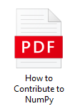
PRINT
OPEN DELETE
heyzine.com/flip-book/3e66a13901
Notes:
And with a PDF, you could print more copies!

Slide 9
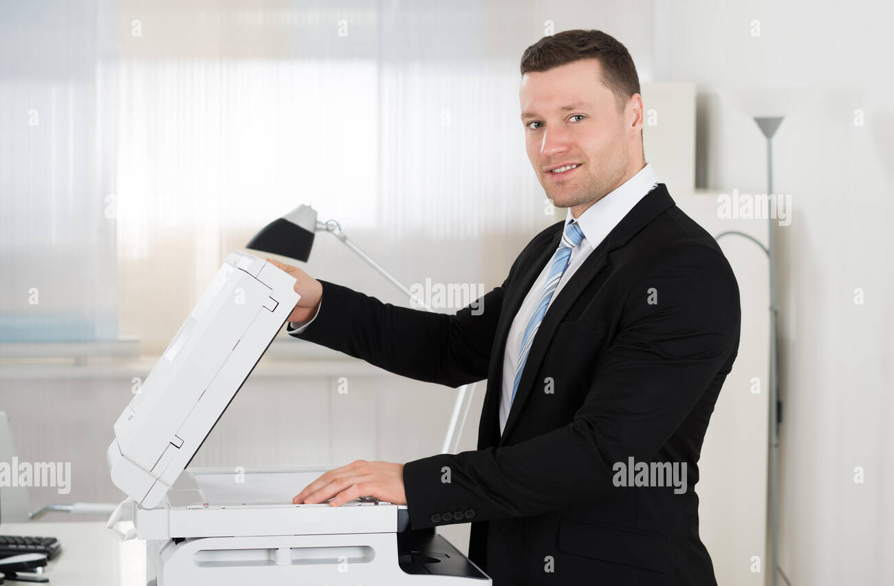
heyzine.com/flip-book/3e66a13901
Notes:
Print more copies, a very reasonable number of copies, with the office printer you certainly have permission to use

Slide 10
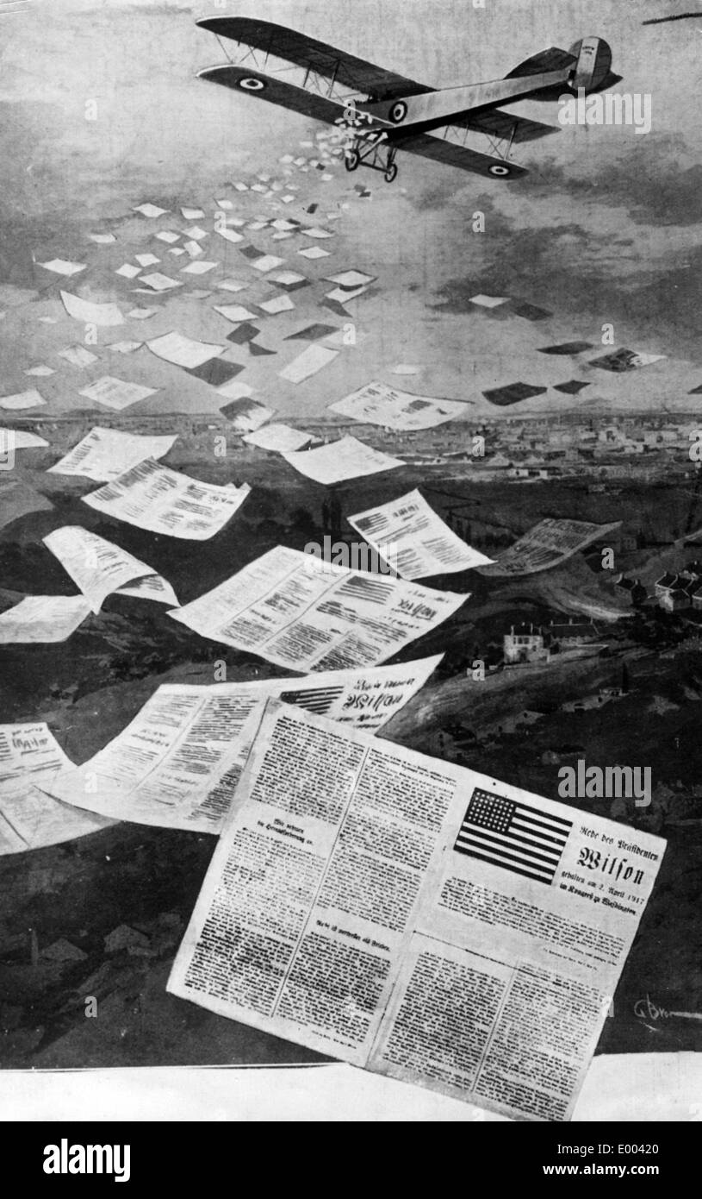
heyzine.com/flip-book/3e66a13901
Notes:
And if you want, drop off copies to your co-workers, friends, dogs or loved ones!

Slide 11
I’ll go through the comic in the talk.
So you can read it now or later
No need to rush!
:)
Notes:
And pssst, hey! I’ll go through the comic in the talik. So you can read it now or later, no rush!

Slide 12
Comics in NumPy? More Likely
Than you Think!
Mars Lee
PyData NYC 2023
Notes:
Alright, alright, enough shenanigans. Let’s get to the talk.

Slide 13
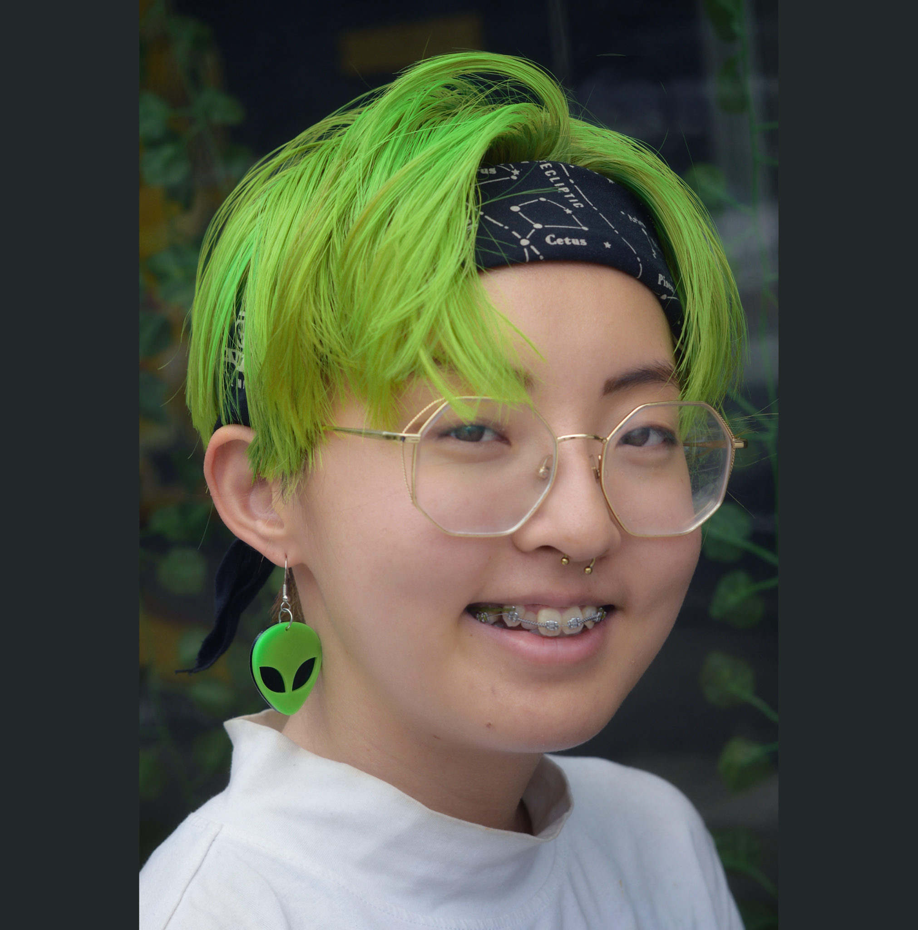
Looking for a job!
Data Viz + Analysis
Mars Lee
PyData NYC 2023
Notes:
Ah, sike! First, Here’s a quick introduction of myself: My introduction is: that I’m looking for a job! Prepare for the strangest job interview of your life.

Slide 14


Notes:
Imagine that you’re reading documentation. You’re doing your due diligence, understanding how a library or API works.

Slide 15


Notes:
But… it’s pretty dry. Boring even? Page after page, you’re reading but not really understanding. You flip back and forth, trying to find that one thing you need.

Slide 16


Notes:
You start thinking to yourself, where did my life go wrong?

Slide 17

Notes:
Well, I can’t answer the last question, but I can answer the first one about documentation!

Slide 18
Notes:
And the answer is comics! Documentation as comics!

Slide 19

Notes:
But wait- you may be asking yourself

Slide 20
What?
Why?
How?
Notes:
What? Why? How?

Slide 21
Overview
What are these comics?
Page by page
Notes:
Reasonable question. Comics? Huh? So let do an overview of this talk.

Slide 22
Overview: Why?
Origins:
How handing out 300 comics at
SciPy 2022 led to a grant
Inspirations:
Contributor Experience
Manga
Notes:
We will cover the Origins, the Inspiration.

Slide 23
Overview: How?
Brainstorming:
with the NumPy community
Changing direction
Based on feedback
Narrowing it down
Based on a true story!
Notes:
Brainstorming, taking Feedback, Narrowing it down

Slide 24
Overview: How?
Peek into the artist studio:
Writing a script
Thumbnailing
Visual metaphors
Notes:
Peek into the artist studio

Slide 25
Overview: How
Integrating artistic processes
into open source principles + platforms:
How do you "PR review" a comic?
Notes:
Integrating artistic processes
into open source principles + platforms:

Slide 26
Overview: Why?
Deconstructing the myth
of the solo virtuoso
Under-represented skills
How can we better support artists?
Notes:
And a unusual and interesting final section. We’ll came back to that.

Slide 27
Overview
Tells a story of:
3 students
2 mid-terms
1 open source library
Notes:
These comics tell a story

Slide 28
Overview
Tells a story of:
Why NumPy is useful
How to use NumPy
Oh wait… this is painful…
Can we improve this?

Slide 29
Overview
Tells a story of
Yes we can! Because NumPy is open source!
Wait… what is open source?
How do we contribute to NumPy?

Slide 30
Overview
Tells a story of:
NumPy is built by the people who use it
Scientists!
Students!

Slide 31
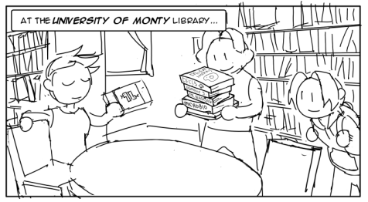
Overview
Notes:
We start at the University of Monty library

Slide 32
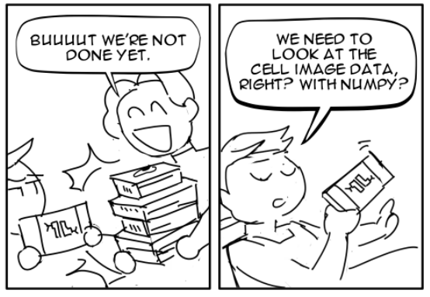
Overview
Notes:
These students finished a lab and need to look at cell images with NumPy.

Slide 33
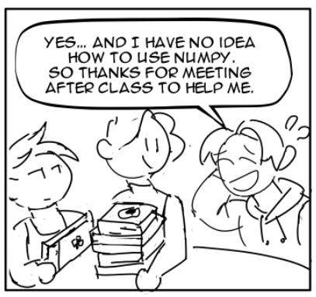
Overview
Notes:
One of them doesn’t know how to use NumPy, another one does. So they help each other.

Slide 34
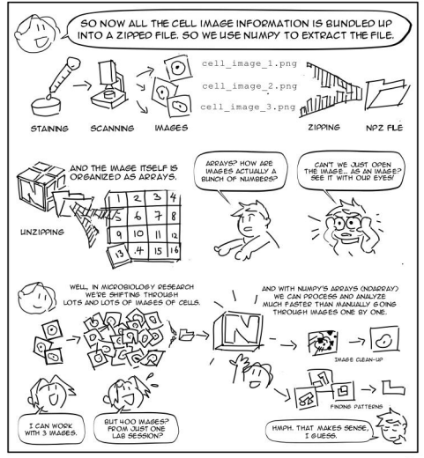
Overview
Notes:
The comics move between story and technical information. Here’s a big one how “Why use NumPy in microbiology”? Why arrays instead of images? You can read this fully on page 2.

Slide 35
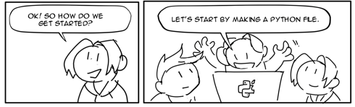
Overview
Notes:
We then follow step-by-step with the students as they use NumPy.

Slide 36
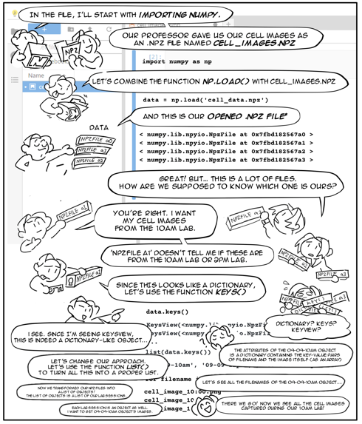
Overview
Notes:
However… you know how you start doing something because it looks easy, and then becomes increasingly difficult? And you can’t step away from it because, “no, I got it this time?”. That’s what this entire page 3 is about. It’s about feeling that way with NumPy

Slide 37
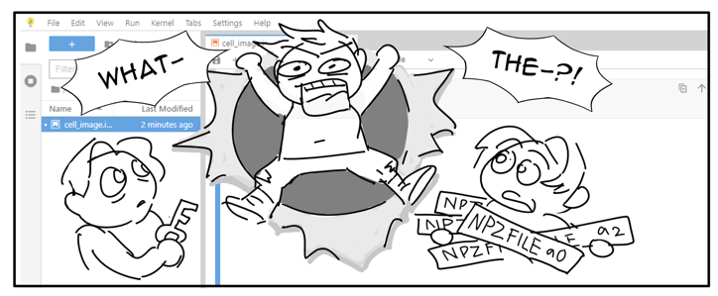
Overview
Notes:
A student bursts in. Wait, what, what?

Slide 38
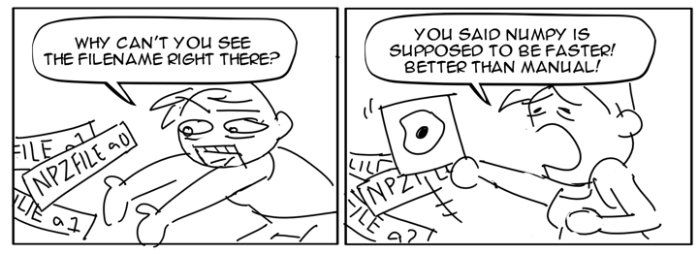
Overview
Notes:
Why is NumPy like that? This is a huge usability problem! I can’t easily see the npz, the filename!

Slide 39
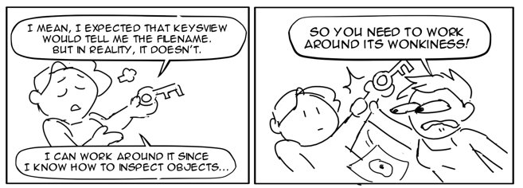
Overview
Notes:
And now we have the back and forth “Well you just need to do this in this specific way and everything (except one thing) will be fine.”

Slide 40
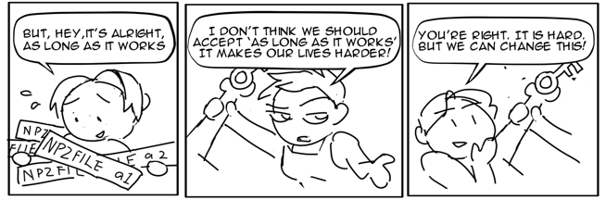
Overview
Notes:
Each student has a different approach. One is accepting of NumPy as is. The other is critical- NumPy can be better. And the last one agrees- NumPy can be better and we can make it better!

Slide 41
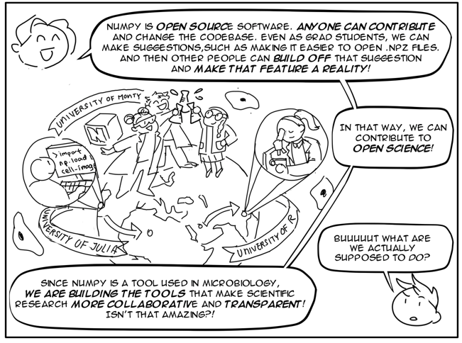
Overview
Notes:
We have a brief introduction into the wide beautiful world of open source and open science. To strive for the ideals and values, to “build the tools that make scientific research more collaborative and transparent”!

Slide 42
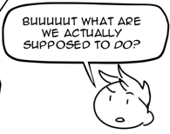
Overview
Notes:
But also, what, what are we supposed to do? How do we act on those ideals and make NumPy better?

Slide 43
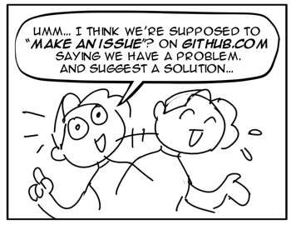
Overview
Notes:
What are the steps?

Slide 44
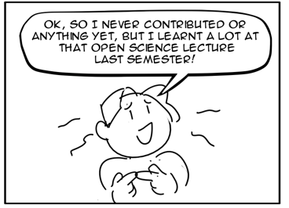
Overview
Notes:
Hmm, this student believes in the value of open source, but hasn’t contributed anything before, not even submitted an issue yet.

Slide 45
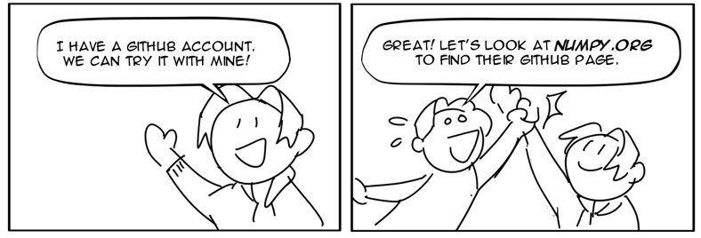
Overview
Notes:
Gasp! Well don’t worry. One of them has a Github account, so the three of them will make an issue about the usability problem in NumPy.

Slide 46
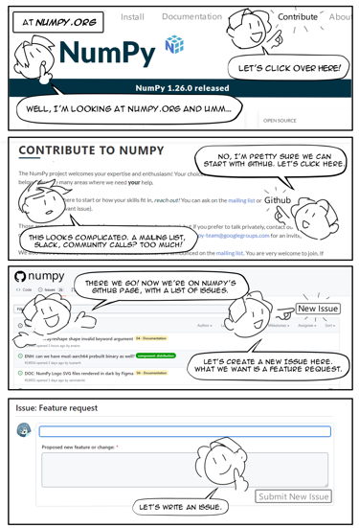
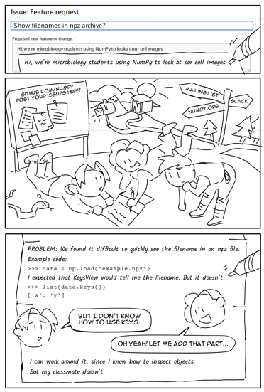
Overview
Notes:
We then have 5 more pages going step by step. Of looking at NumPy.org, looking at Github

Slide 47
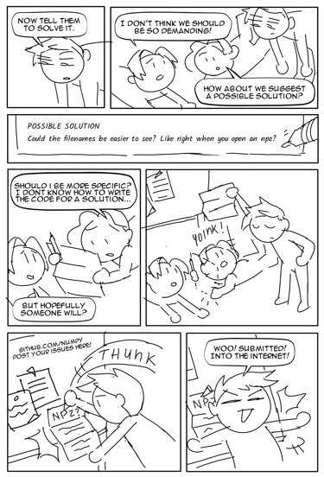
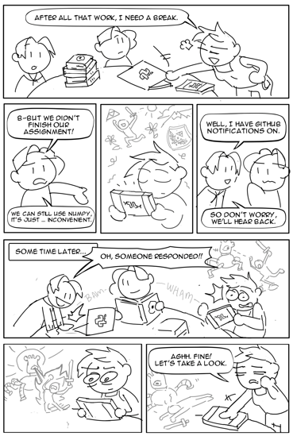
Overview
Notes:
5 more pages, of the nerve-wracking anxiety of writing your first issue!

Slide 48
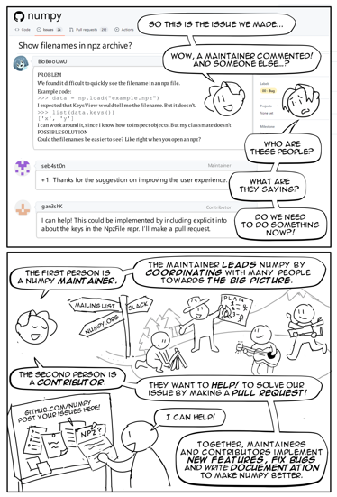
Overview
Notes:
5 more pages, explaining the contributor workflow!

Slide 49
Overview
Notes:
Alright, Hate to say it, but I’ll say it: Read the docs. Read the comics. It’ll tell you everything you need to know.

Slide 50
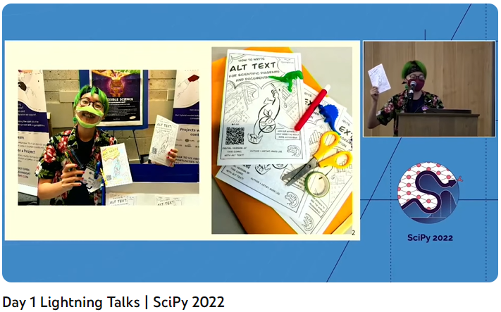
Origins
How
handing out
300 comics at SciPy 2022 led to a grant
Notes:
So, that was an overview of the comics. Now let’s get into the origins. How did this all start?
Thank you hosts David
https://www.youtube.com/watch?v=BEuKtwsdmvU

Slide 51
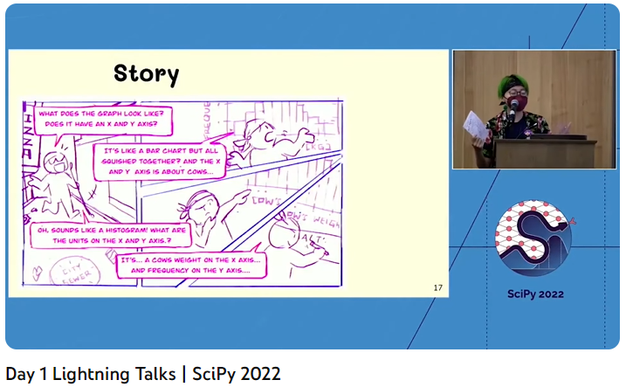
Origins
How
handing out
300 comics at SciPy 2022 led to a grant
Notes:
Lightning talks, David and
https://www.youtube.com/watch?v=BEuKtwsdmvU

Slide 52
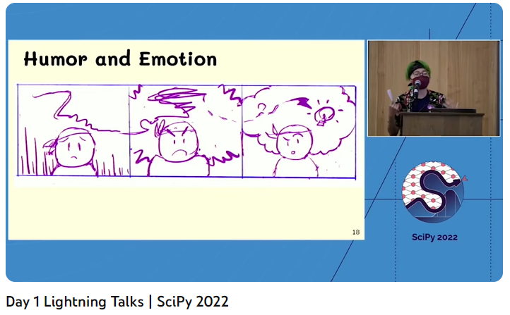
Origins
How
handing out
300 comics at SciPy 2022 led to a grant
Notes:
https://www.youtube.com/watch?v=BEuKtwsdmvU

Slide 53
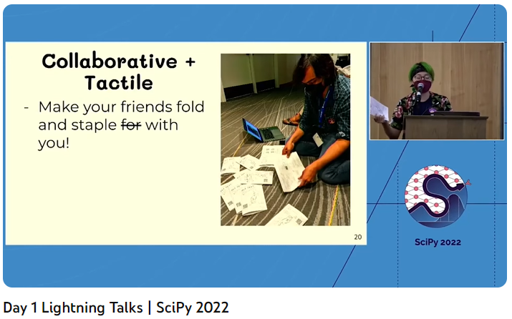
Origins
How
handing out
300 comics at SciPy 2022 led to a grant
Notes:
https://www.youtube.com/watch?v=BEuKtwsdmvU

Slide 54
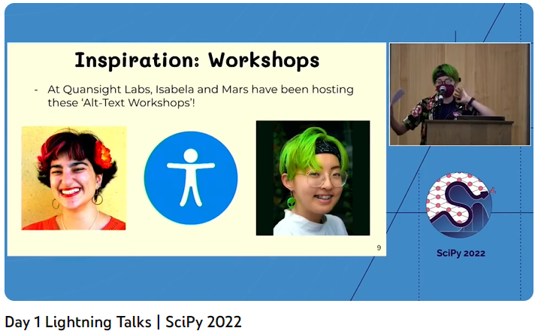
Origins
How
handing out
300 comics at SciPy 2022 led to a grant
Notes:
Visual notes
https://www.youtube.com/watch?v=BEuKtwsdmvU

Slide 55
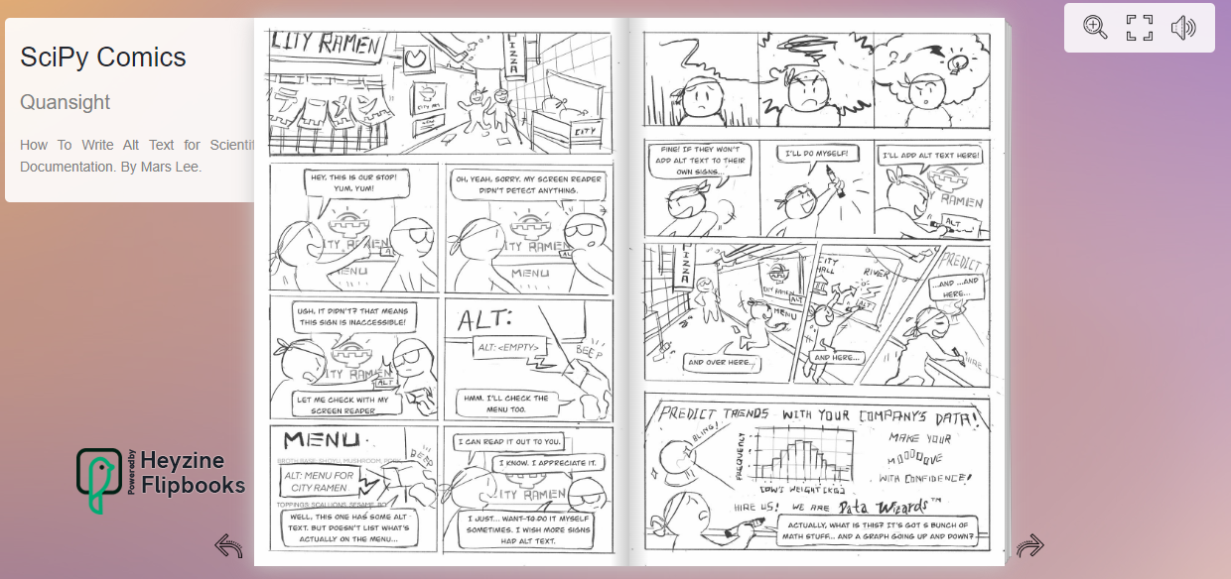
Origins
How
handing out
300 comics at SciPy 2022 led to a grant
Notes:
https://www.youtube.com/watch?v=BEuKtwsdmvU

Slide 56
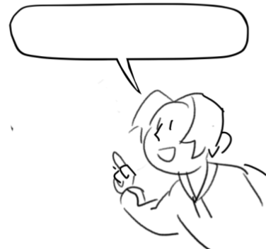
Origins
What else could I
make comics for?

Slide 57

Origins
What else could I
make comics for?
Contributing to NumPy for 3 years

Slide 58
Origins
What else could I
make comics for?
Contributing to NumPy for 3 years
Website
Writing meeting minute notes

Slide 59
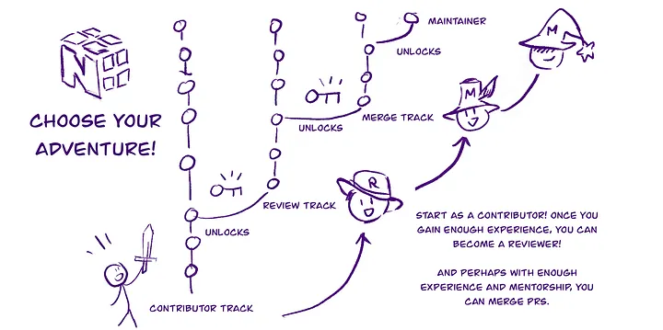
Origins
Prototype
August 2022
Based on discussion of contributor → maintainer pathway
Notes:
How can we tell people that these pathways are possible?
https://github.com/numpy/archive/blob/main/docs_team_meetings/docs-2022-09-12.md

Slide 60

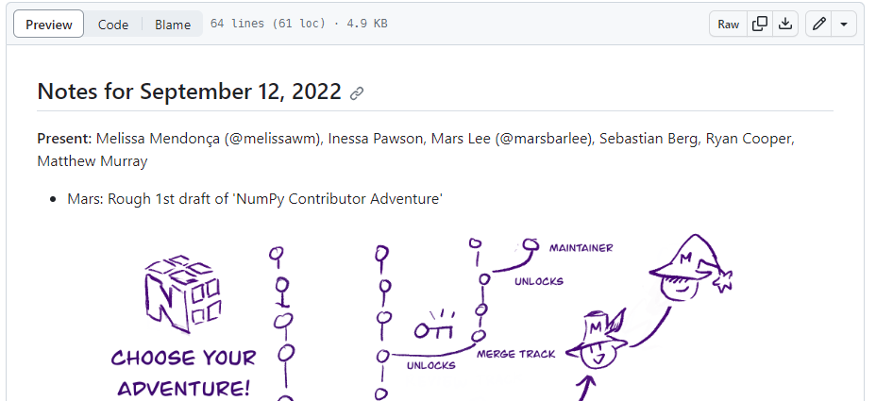
Origins
Aug 2022
Notes:
https://github.com/numpy/archive/blob/main/docs_team_meetings/docs-2022-09-12.md

Slide 61
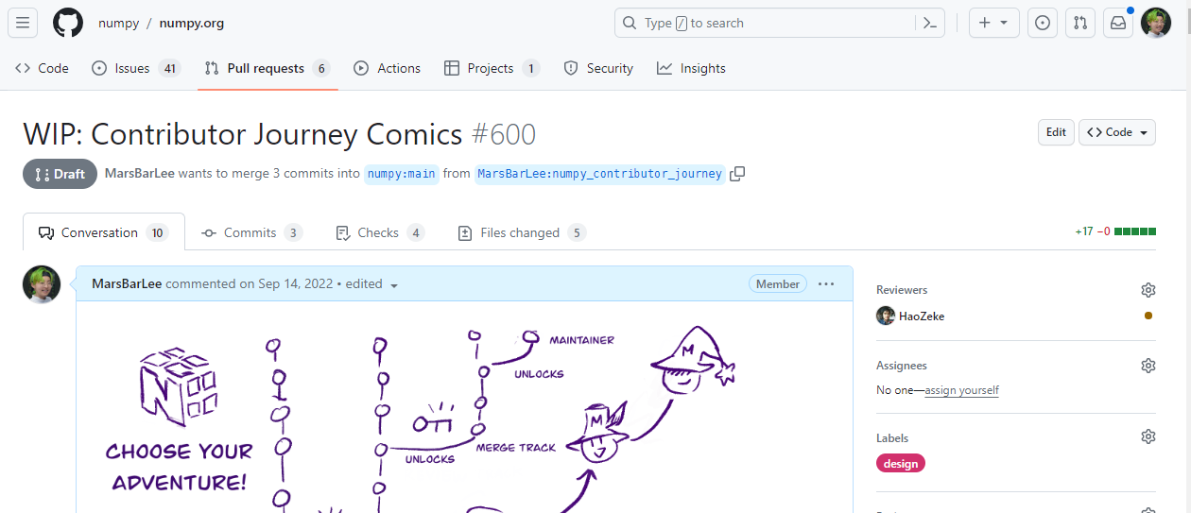
Origins
Make a Github issue
Notes:
https://github.com/numpy/numpy.org/pull/600#issuecomment-1258157615

Slide 62
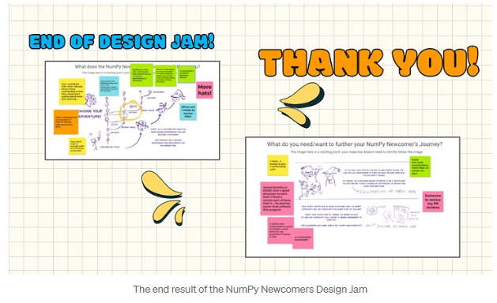
Origins
Gather feedback from NumPy’s Newcomers Hour
Notes:
https://www.youtube.com/watch?v=BEuKtwsdmvU

Slide 63
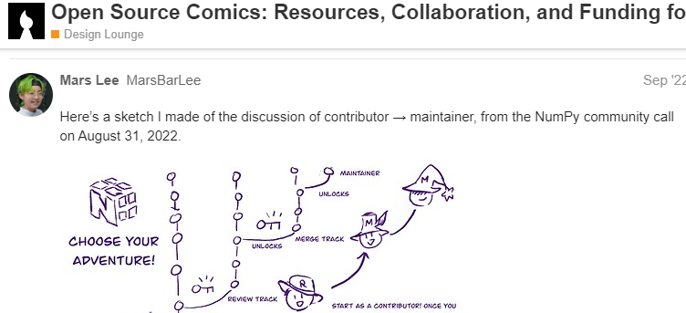
Origins
Share with other artists
Notes:
https://discourse.opensourcedesign.net/t/open-source-comics-resources-collaboration-and-funding-for-making-comics-for-open-source-projects/3130/3

Slide 64
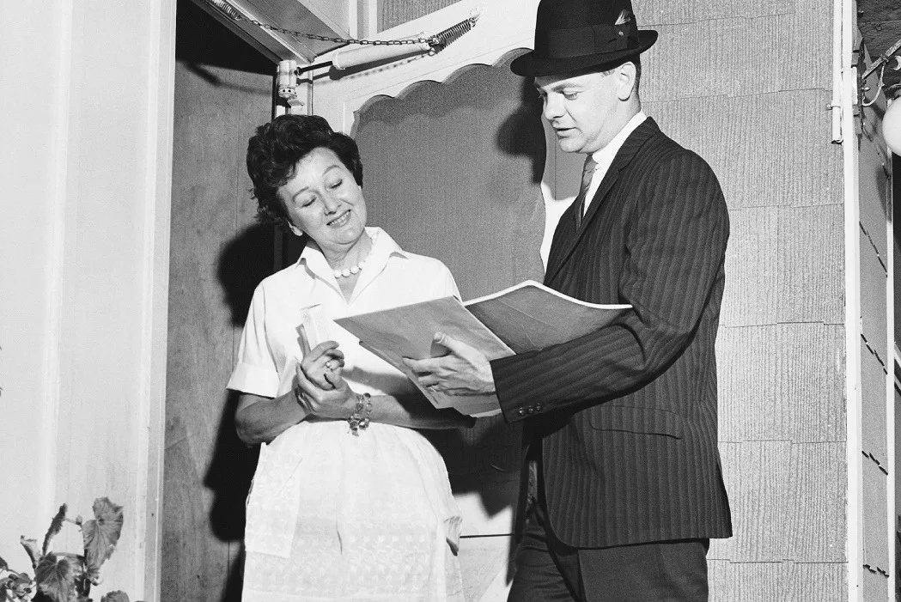
Origins
A few months of shopping the idea around…
Notes:
https://www.youtube.com/watch?v=BEuKtwsdmvU

Slide 65
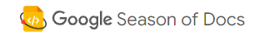
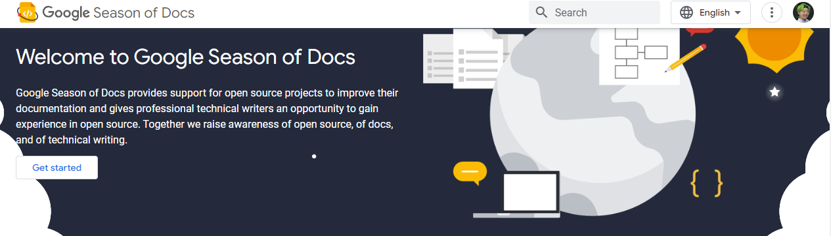
Origins
Notes:
https://www.youtube.com/watch?v=BEuKtwsdmvU

Slide 66
Origins
April 2023
Submit proposal?
Notes:
https://www.youtube.com/watch?v=BEuKtwsdmvU

Slide 67
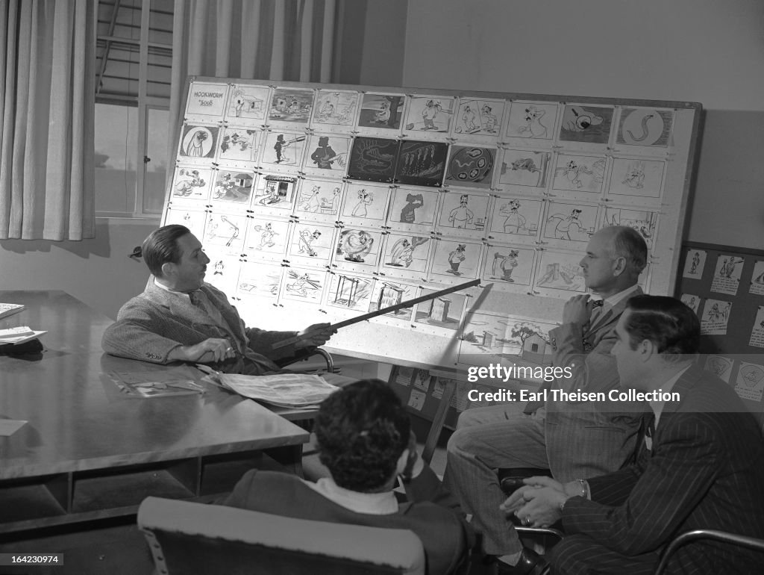
Origins
Never worked on an academic grant
More of a pitch ala Disney animation
Notes:
https://www.youtube.com/watch?v=BEuKtwsdmvU

Slide 68
Origins
Submit with project mentors:
Mukulika Pahari
Ross Barnowski
Notes:
https://www.youtube.com/watch?v=BEuKtwsdmvU

Slide 69
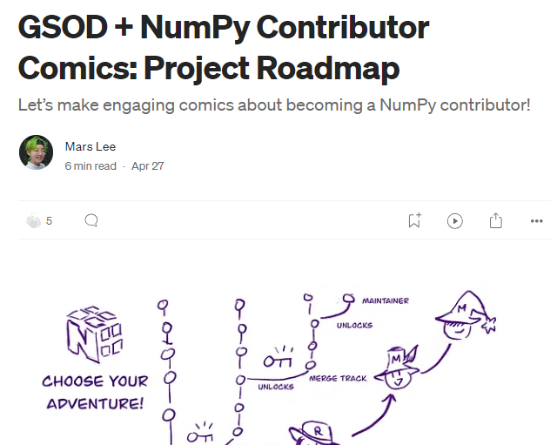
Origins
Publish a project roadmap
Notes:
https://www.youtube.com/watch?v=BEuKtwsdmvU

Slide 70
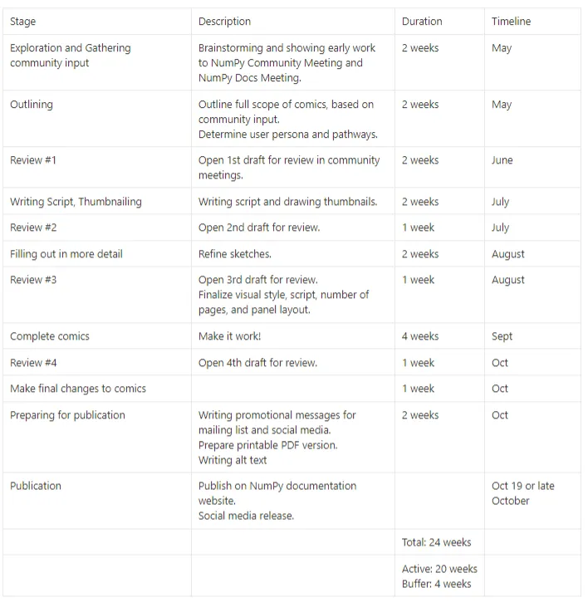
Origins
Timelines!
Budgets!
Key personnel!
Notes:
https://www.youtube.com/watch?v=BEuKtwsdmvU

Slide 71
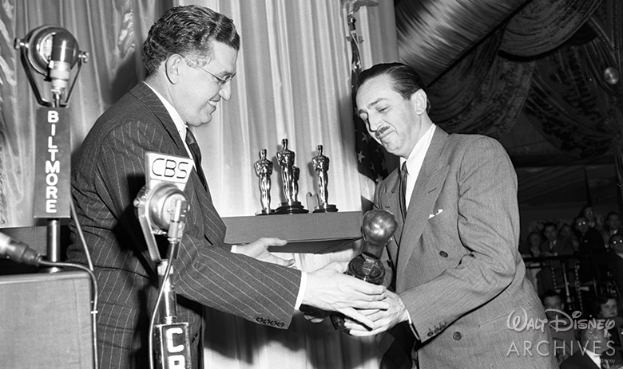

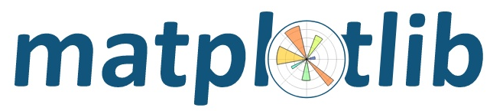
Acceptance!
Notes:
https://www.youtube.com/watch?v=BEuKtwsdmvU

Slide 72
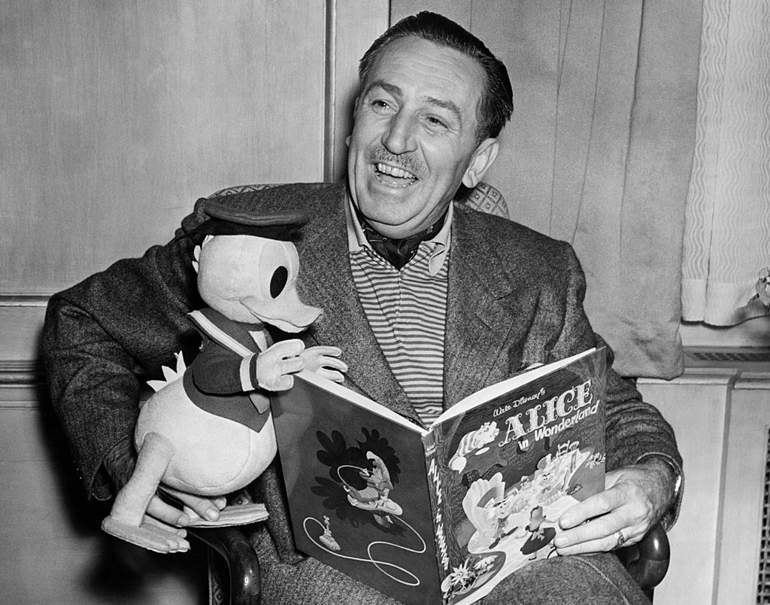
LET’S GOOOOO!
Notes:
https://www.youtube.com/watch?v=BEuKtwsdmvU

Slide 73
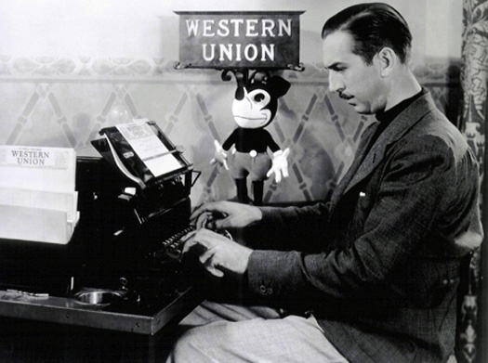
Uh oh!
Notes:
Written myself into a corner

Slide 74

Uh oh!
Recognizing differences’
between my knowledge of
Growing niche field
vs
Open source library of 15+ years

Slide 75
Uh oh!
Recognizing differences between
Few players
vs
Many players
“Over 32,000 packages on GitHub depend on NumPy, and
6 million users visit our website every month.”

Slide 76
Challenge
Build on existing work
But also create something new
Tell a story
But also technical info
Driven by community
But also show artistic vision

Slide 77

Challenge
Build on existing work
But also create something new
Tell a story
But also technical info
Driven by community
But also show artistic vision
Innovate!
Respect!

Slide 78

Challenge
Build on existing work
But also create something new
Tell a story
But also technical info
Driven by community
But also show artistic vision
Can I do both?

Slide 79

Challenge
Build on existing work
But also create something new
Tell a story
But also technical info
Driven by community
But also show artistic vision
Let’s look at existing works that already do both!

Slide 80

Challenge
Build on existing work
But also create something new
Tell a story
But also technical info
Driven by community
But also show artistic vision
Great!
Let’s get inspired!

Slide 81
Inspiration
Drawing upon existing work → new challenge
NumPy documentation
NumPy Docs meeting
Diataxis framework
Contributor experience
Manga’s Guide
The Turing Way

Slide 82

Inspiration
Drawing upon existing work → new challenge
NumPy documentation

Slide 83


Inspiration
Drawing upon existing work → new challenge
NumPy Doc meetings

Slide 84

Inspiration
Drawing upon existing work → new challenge
Diataxis framework

Slide 85
Inspiration
Drawing upon existing work → new challenge
Diataxis framework

Slide 86

Inspiration
Drawing upon existing work → new challenge
Contributor Experience
Notes:
Melissa, Inessa and Noa

Slide 87

Inspiration
Drawing upon existing work → new challenge
Notes:
Melissa, Inessa and Noa

Slide 88

Inspiration
Drawing upon existing work → new challenge
Notes:
Melissa, Inessa and Noa

Slide 89


Slide 90
Inspiration

Slide 91


Slide 93



Notes:
Wait, let’s rewind the tapse. If you see between these two keyframes, is a frame, is a in-between frame.

Slide 94
Notes:
And in this in between frame, we somehow take all these inspirations

Slide 95
Notes:
And turn them into a single comic you’re now holding in your hands.

Slide 96
How?
Notes:
And the questions is… how? How did we turn this alchemy-like, into wisdom?

Slide 97

How?
Bring the comic making process to NumPy

Slide 98
MARS
How?
Bring the comic making process to NumPy
Notes:
And us Lees, we know a thing or two about making comics.

Slide 99
MARS
How?
Pitch
Acceptance
Brainstorming
Narrow down + select final idea
Script-writing
Thumbnailing
Art
Review
Publish

Slide 100
How?
Brainstorming:
with the NumPy community
Asking domain experts a
most unexpected question… comics?!

Slide 101


How?
Brainstorming:

Slide 102
How?
Brainstorming:
Notes:
felt a little stilted. That format reinforces the primacy of words over images, and I wanted to nudge it in the other direction.

Slide 103


How?
Brainstorming:
think in visual and non-linear ways.
Notes:
I want these domain experts to feel like they;re writers and storyboard artists, sharing that electrifying energy of creativity and unlimited possibilities

Slide 104


How?
Brainstorming:
think in visual and non-linear ways.
Notes:
Google Jamboard, a digital whiteboard.A digital whiteboard where anyone can leave comments with sticky notes, add and drag images around or even draw with their mouse

Slide 105
How?
Brainstorming:
think in visual and non-linear ways.
Notes:
Jamboarded on my prototype

Slide 106
How?
Brainstorming:
20 minute session
Announced on NumPy mailing list
Went to 3 different audiences
NumPy Community Call
NumPy Docs Call
NumPyew Newcomers

Slide 107

How?
Brainstorming:
Notes:
With Newcomers, there was a focus on non-linear pathways.

Slide 108

How?
Brainstorming:
Notes:
At the Docs meeting, how the metaphor to explain contributon pathways may fall flat.

Slide 109

How?
Brainstorming:
Notes:
At the Community meeting, the difficulty of quantifying the un-quantifable, especially in roles and expectations.

Slide 110
How?
Consolidate feedback
From 3 different stakeholders
Docs Call
Documentation as comics
Newcomers
Aimed at newcomers
Community Call
Reflects community practices
Notes:
scoop up different opinions. How do I bring these 3 different threads together?

Slide 111

How?
Notes:
Too long and milquetoast. I’m sure you’ve seen very long, disjoined documentation before.

Slide 112
How?

Slide 113
How?
Narrowing it down
Squirreling away
What is my artistic vision in all this?

Slide 114




How?
Narrowing it down
Talking to other artists
Tony Fast
Notes:
Fellow artist, open source advocate, muse and editor

Slide 115
How?
Narrowing it down
Multiple pathways and roles you
can take on in NumPy

Slide 116
How?
Narrowing it down
Multiple pathways and roles you
can take on in NumPy → Tell one story
Notes:
Interested in mapping anthropologically, as possibilities. Back to telling one story

Slide 117


How?
Narrowing it down
Tell one story → Based on a true story!
Notes:
Ross, project mentor. Github issue: https://github.com/numpy/numpy/pull/23357

Slide 118

How?
Narrowing it down
Tell one story → Based on a true story!
Notes:
Ross, project mentor. Github issue: https://github.com/numpy/numpy/pull/23357

Slide 119

How?
Narrowing it down
Tell one story → Based on a true story!
Notes:
Ganesh PR: https://github.com/numpy/numpy/pull/23357

Slide 120

How?
Peek into the artist studio:

Slide 122
Inspiration

Slide 123
How?
Peek into the artist studio:
Tools
Writing a script
Visual metaphors
Process
Notes:
The artist studio is where it all happens

Slide 124

How?
Peek into the artist studio:
Tools
Notes:
Let’s get something out of the way first: Yes, everything is hand drawn. No AI, no filters.

Slide 125



How?
Peek into the artist studio:
Tools: my hands, a 10 year old Wacom Bamboo tablet, Krita
Notes:
Tools so simple, you could do it.

Slide 126

Overview: How?
Peek into the artist studio:
Writing a script
Notes:
12 page scripts, covering 16 pages of the comic

Slide 127
Overview: How?
Peek into the artist studio:
Writing a script
Find the overarching story:
NumPy is made by the people who use it- scientists!
The emotional core
Scratch my itch
Notes:
12 page scripts, covering 16 pages of the comic

Slide 128
Overview: How?
Peek into the artist studio:
Writing a script
Invent characters- scientists!
The emotional core
I don’t like this about NumPy…
We can fix it!
Notes:
12 page scripts, covering 16 pages of the comic

Slide 129

How?
Peek into the artist studio:
Invent characters
“3 stooges energy”
Notes:
Let’s muck around and find out

Slide 130

How?
Peek into the artist studio:
Invent characters
“3 stooges energy”
Notes:
12 page scripts, covering 16 pages of the comic

Slide 131

How?
Peek into the artist studio:
Invent characters
“3 stooges energy”
Notes:
12 page scripts, covering 16 pages of the comic

Slide 132

How?
Peek into the artist studio:
Invent characters
“3 stooges energy”
Notes:
12 page scripts, covering 16 pages of the comic

Slide 133


How?
Peek into the artist studio:
Visual metaphors
Notes:
12 page scripts, covering 16 pages of the comic

Slide 134

How?
Peek into the artist studio:
Visual metaphors
Notes:
12 page scripts, covering 16 pages of the comic

Slide 135

How?
Peek into the artist studio:
Visual metaphors
Notes:
12 page scripts, covering 16 pages of the comic

Slide 136
How?
Peek into the artist studio:
Process:
Thumbnailing to script
Panel layout and flow
Laying out dialogue and speech bubbles
Photoshop Github screenshots
First pass
Final lineart
Editing
…
Notes:
Hand drawn. No AI, no filters. Tools so simple, you could do it.

Slide 137

How?
Peek into the artist studio:
Notes:
Hand drawn. No AI, no filters. Tools so simple, you could do it.

Slide 138



How?
Notes:
Sketches are pretty rough, because I already have a good idea of what it will look like in my head.

Slide 139



How?
Notes:
2nd panel with world: more focused on composition than details. Keeping the big pictur ein mind.

Slide 140


How
How do you "PR review" a comic?
Notes:
How do you "PR review" a comic? Take my two specialized domain knowledges honed over years.

Slide 141
How
How do you "PR review" a comic?
Notes:
How do you "PR review" a comic? Take my two specialized domain knowledges honed over years.

Slide 142
How
How do you "PR review" a comic?
Integrating artistic processes
→ existing open source processes + platforms
Notes:
How do you "PR review" a comic? Take my two specialized domain knowledges honed over years.

Slide 143

How
How do you "PR review" a comic?
Track in a Github issue

Slide 144
How
How do you "PR review" a comic?
Track in a Github issue
Announce on NumPy mailing list
Present sketches and script at Community and Doc calls
Comments can be given on the NumPy calls or Github or Google Doc
Notes:
So the review had a similar processtto brainstorming

Slide 145


How
How do you "PR review" a comic?
Comments on script can be left on Github or Google Doc

Slide 146

How
How do you "PR review" a comic?
Transcribe feedback from calls

Slide 147

How
How do you "PR review" a comic?
Ask specific parts for feedback
Notes:
Bullet point list with reference to page numbers, Themes, Story telling, accuracy

Slide 148
How
How do you "PR review" a comic?
Explain my domain knowledge + artistic process
Integrate into open source platforms and principles
Invite the other side in specific and engaging ways
Notes:
Bullet point list with reference to page numbers, Themes, Story telling, accuracy

Slide 149

How
How do you "PR review" a comic?
Make repository of all artifacts the same way as a code contribution
Notes:
Treat art with same level of respect and transparency

Slide 150
How…
Integration
Explain
Processes
Domain expert
Notes:
Treat art with same level of respect and transparency

Slide 151
How…?
Integration
Assimilation
Explain
Simplify
Processes
As an outsider
Domain expert
Under-represented skills
Notes:
But… after months and months of this work, I started to feel something… familiar. And uncomfortable. The grant was going great, but my mind wasn’t feeling great.

Slide 152
Why…? Do I feel like this?
Integration
Assimilation
Explain
Simplify
Processes
As an outsider
Domain expert
Under-represented skills
Notes:
These words, actions, in mind, they started to tip to the other side.. Why, why do I feel like this?

Slide 153
Why?
Deconstructing the myth
of the solo virtuoso
Notes:
As so, we’ve come to the final section. We’ve come back to why?

Slide 154

Why?
Deconstructing the myth
of the solo virtuoso
Notes:
4 years ago, almost to this very day, in this same building, in this very same room,. I was at PyData NYC 2019. As a Diversity Scholar.

Slide 155

Why?
Deconstructing the myth
of the solo virtuoso
Notes:
I gave a 5 minute lightning talk, about comics, much like I am doing right now. Some of you might recognize Codesprite- I know you do Saul, because you were in the audience 4 years ago.

Slide 156
Why?
Deconstructing the myth
of the solo virtuoso
Notes:
Someone else was in the audience- Ralf, the director of Quansight Labs. And once I finished my talk, I was offered a job.

Slide 157

Why?
Deconstructing the myth
of the solo virtuoso
Notes:
In fact, I wrote a whole blog post about that incredible experience. So Diversity Scholars in the audience, I know you’re here because I talked to Albina, the organizer for this year’s Diversity Scholars- this could also be your chance.

Slide 158

Why?
Deconstructing the myth
of the solo virtuoso
Notes:
And I took full advantage of that job, that opportunity given to me.

Slide 159
Why?
Deconstructing the myth
of the solo virtuoso
Notes:
And I took full advantage of that job, that opportunity given to me. I made comics on alt-text, I hosted workshops, I traveled the country and world. And now full circle, given a platform to share what I’ve learnt.

Slide 160
Why?
Deconstructing the myth
of the solo virtuoso
Comics in NumPy? More Likely
Than you Think!
Notes:
But remember the title of this talk? Comics in NumPy? More Likely Than You Think

Slide 161

Notes:
The title, it implies that comics shouldn’t be in NumPy. Or that you wouldn't think so. I spent a whole 20 minutes telling you that, yes comics can.

Slide 162

Notes:
And the title, it’s based off a terriblely old meme.

Slide 163
Notes:
But both that meme and title talk about removing the unwanted, the unexpected. Uh oh, get rid of that!

Slide 164
Why…? Do I feel like this?
Integration
Assimilation
Explain
Simplify
Processes
As an outsider
Domain expert
Under-represented skills
Notes:
So while the grant itself was going great, like I said, my mind wasn’t.

Slide 165
Why…?
Am I worth the investment?
The risk?
The budget?
Notes:
That I am worth the investment, the risk people took on me.

Slide 166
Why…?
Because I have to set the path for
others like me
Notes:
That I have to set the path forward for others like me, waiting for their own opportunities.

Slide 167
Why…?
Because I have to prove I’m worth keeping
Notes:
That I have to prove to the world that someone like me is worth keeping.

Slide 168
Why…?
Notes:
So I turned away from my friends. My partner. My hobbies. I turned away from it all, so I could do more work.

Slide 169
Why…?
I promised
I have to, have to, have to…
Notes:
I have to complete all 16 pages, I promised, by the grant deadline. I have to, I have to, I have to…
Prove the ideals of the grant, open source, of art.

Slide 170
Why…?
Notes:
But after talking to therapist and my friends, I realized that ….

Slide 171
Why…?
I am not the only one.
Notes:
I am not the only one. There are a few like me, and it’s difficult for us.

Slide 172
Why…?
Notes:
But I don’t need to burn myself to prove that there’s light in the world. I can’t let myself be a martyr.

Slide 173
Why…?
I’m not good despite who I am
I am good enough as is.
Notes:
I’m not good despite who I am
I am good enough as is.

Slide 174
Why…?
Notes:
And so I made a decision. Instead of thinking “I have to do this”…, I decided to think “What do I want to do?”
What will make me happy and whole?

Slide 175

Yes!
Notes:
And so I went to an emo party and went crowd surfing for the first time! Heck yesss!

Slide 176

Yes!
Notes:
Tabled for a hackerspace at the Coney Island Maker Faire! That’s right, repping Brooklyn, home of NYC Resistor

Slide 177


Yes!
Notes:
Dressed up for Halloween! Yes, it’s THE spiderman!

Slide 178


Yes!
Notes:
Invented silly games and hacky contraptions for stapling comics! Shout out to my man John- told ya!

Slide 179


Yes!
Notes:
Brought 7 friends to a hackerspace, Hive 76, in Philadelphia! And I met this guy, Evan, at the MakerFaire!

Slide 180

Yes!
Notes:
Modeled for Home Assistant’s, an open source home automation software, new logo and merch! Paulus and Madalina, I’m waiting for my influencer shirt to come in the mail!

Slide 181
How?
How can we better support the under-represented in Scientific Python?
Reach out to groups with similar skills and backgrounds eg
Artists → Open Source Design

Slide 182
How?
How can we better support the under-represented in Scientific Python?
Re-connect with your community
and allies
Step away from the pressure of
‘being the only one’

Slide 183

What’s next?
Complete NumPy comics last 6 pages
Notes:
Spoiler alert! I didn’t finish everything I wanted! And that’s fine. I talked to the project mentors about it, and I’ll continue to make the rest of the pages on my own time- it’s open source after all. The grant kickstarted these comics, but it doesn’t end it either.

Slide 184

What’s next?
Continue making art for communities
and share at conferences + hackerspaces
Notes:
SciPy next year?
DEFCON, Chaos Communciation Camp

Slide 185



What’s next?
Continue making art for communities
and share at conferences + hackerspaces
Notes:
SciPy next year?
DEFCON, Chaos Communciation Camp

Slide 186


What’s next?
Continue making art for communities
and share at conferences + hackerspaces
Notes:
SciPy next year?
DEFCON, Chaos Communciation Camp

Slide 187
What’s next?
Continue making art for communities
and share at conferences + hackerspaces
Step away from art as a full-time job
Notes:
Step away from art as a full-time job

Slide 188
What’s next?
Continue making art for communities
and share at conferences + hackerspaces
Step away from art as a full-time job
Inspire others to make art after sharing my:
Process
Tools
Experiences

Slide 189

What’s next?
Notes:
I’m proud, I’m happy, and I’m ready to walk away and let others take over.

Slide 190

What’s next?
Notes:
And, well, I’ve been doing some deep soul searching recently. And the answer to “What’s next?” is…

Slide 191
Looking for a job!
Data Viz + Analysis
Mars Lee
PyData NYC 2023
Notes:
A job! I did tell you that this would be the strangest job interview of your life.

Slide 192
Looking for a job!
Data Viz + Analysis
Email me at marsbarlee@gmail.com
Hit me up on LinkedIn
To see my portfolio
Mars Lee
PyData NYC 2023

Slide 193


ONLY
$0.00
FREE GIFT
marsbarlee.com
Notes:
And that’s it! That’s the end of the talk. Thank you everyone for coming! In-person attendees, hope you enjoy your merch! If you or a friend want more comics, just look for me in the conference halls, the one with the green hair, can’t miss it. For those watching online, you can get the PDF at marsbarlee.com!

Slide 194

SUBSCRIBE TO THE
FREE GIFT
Notes:
Don’t forget to subscribe to the MCU! The Mars Comics Universe! I’m on Twitter, Mastodon, Instagram and LinkedIn! Thank you and Goodnight!

